Slide 1
RFM Analysis for Marketing

Slide 2
Week 16 RFM Analysis for marketing
1 | Introduction to RFM
2 | RFM analysis for customer segmentation
3 | Case Study

Slide 3






What is RFM Analysis?
RFM analysis is a technique used to categorize customers according to their purchasing behavior.

Slide 4
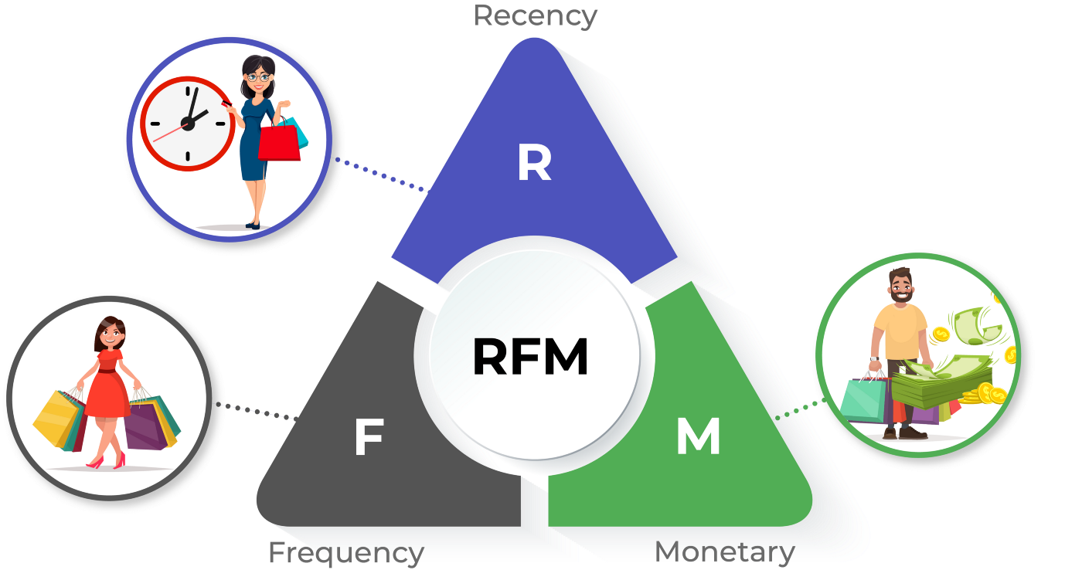

Slide 5
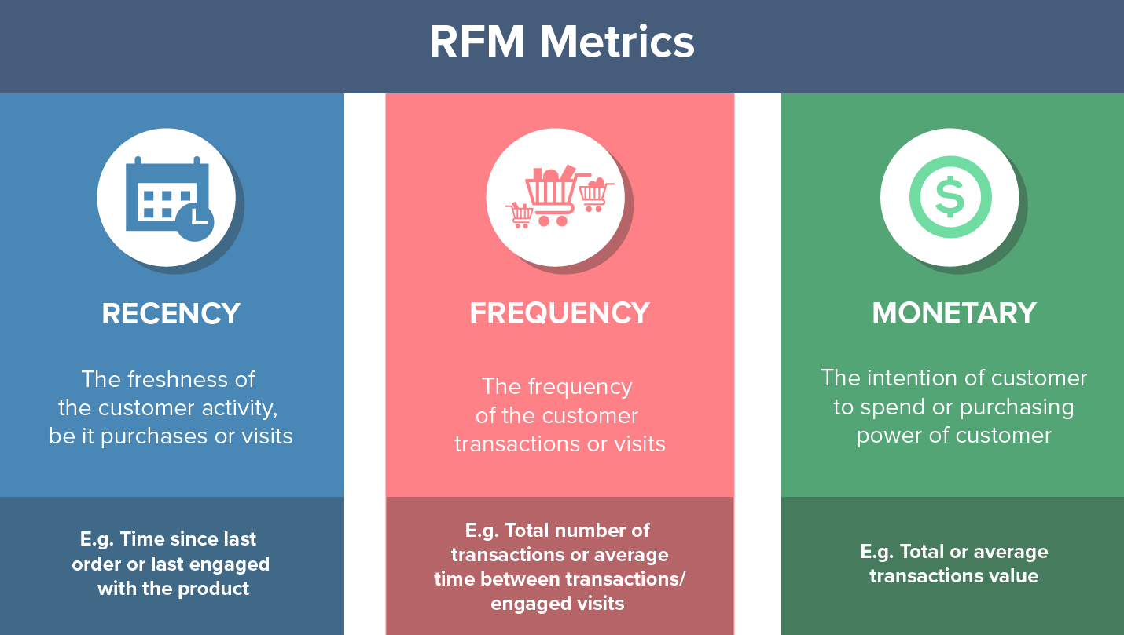

Slide 6
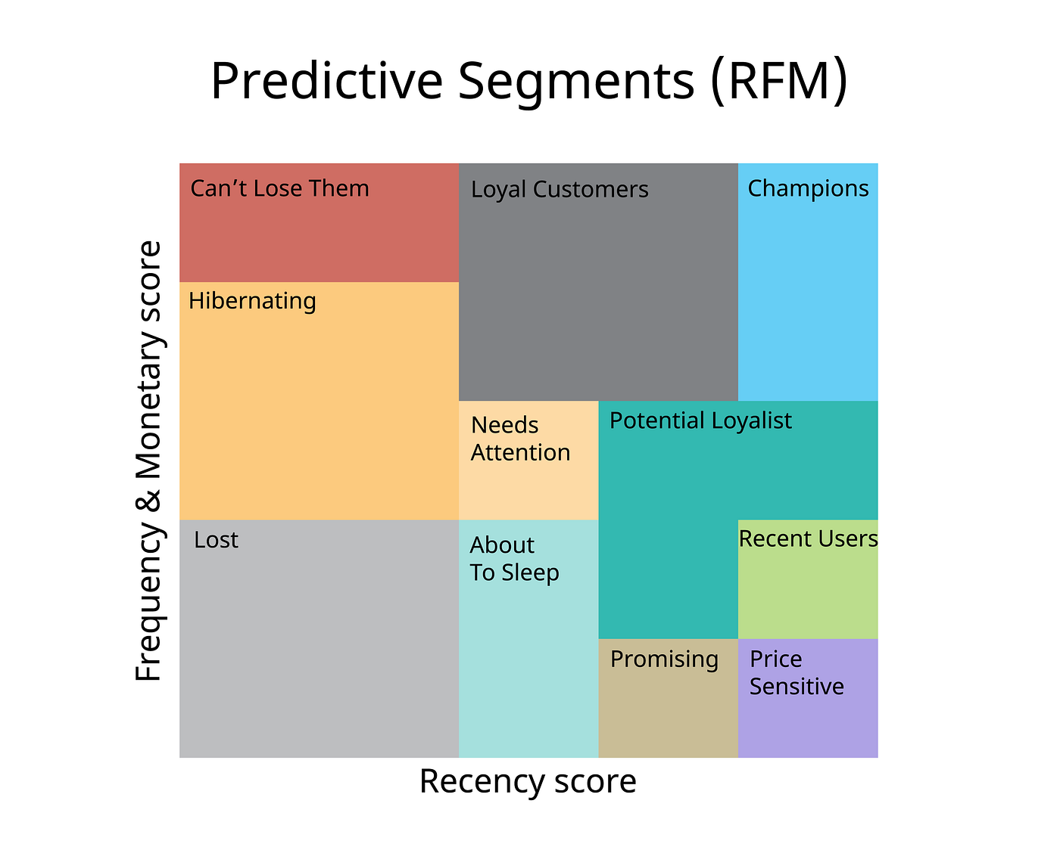

Slide 7
How This Calculate?
Recency: This is the date when the customer made the last purchase. It is calculated by subtracting the customer's last shopping date from the analysis date.
Frequency: This is the total number of purchases of the customer. In a different way, it gives the frequency of purchases made by the customer.
Monetary: It is the total monetary value spent by the customer.

Slide 8
RFM analysis process
Data Collection: customer transactions, interactions, and purchase history. purchase dates, purchase amounts, and interaction timestamps.
Segmentation: Assign a score to each customer based on their Recency, Frequency, and Monetary Value. This can be done using a scale of 1 to 5 or 1 to 10, with higher scores indicating better recency, frequency, or monetary value.
Segment Creation: Create segments based on the combined RFM scores. For example, you might have segments like "High-Value Customers," "Loyal Customers," "At-Risk Customers," and "Inactive Customers."
Analysis and Action: Analyze each segment's characteristics and behaviors. Develop tailored marketing strategies for each segment to maximize engagement, retention, and conversion. For instance, you might offer special discounts to high-value customers or re-engagement campaigns for inactive customers.
Testing and Iteration: Implement your strategies and measure their effectiveness over time. Continuously monitor the results and refine your approach based on the outcomes.

Slide 9
The Business Problem
An e-commerce company wants to segment its customers and determine marketing strategies according to these segments. For example, it is desirable to organize different campaigns to retain customers who are very profitable for the company, and different campaigns for new customers.

Slide 10
Data Set
The Online Retail II data set includes the sales of an online retail store based in the UK between dec1/12/2009 and 09/12/2011. The product catalog of this company includes souvenirs. The vast majority of the company's customers are corporate customers.

Slide 11
Variables
InvoiceNo: Invoice number. A unique number for each transaction. If it starts with C which means cancelled operations.
StockCode: Product code. A unique number for each product.
Description: Product name.
Quantity: It refers to how many of the products in the invoices have been sold.
InvoiceDate: Invoice date.
UnitPrice: Product price (pound)
CustomerID: Unique customer number.
Country: The name of the country where the customer lives.

Slide 12
DEMO…….

Slide 13
Reviews About the Segments
Cant Loose
There are 63 people in this segment.
Shopping was done on average 133 days ago.
The frequency of shopping is 8, the total number of purchases is 63.
A total of £102,54 has been spent.
Action: Even if the last purchase was made 133 days, the total number of purchases is high. It is a group of customers who do not come for a long time, but also make a lot of purchases when they come. We can analyze the process by sending surveys to these customers, and we can be changed by sharing personalized campaigns by e-mail.

Slide 14
Need Attention
There are 187 people in this segment.
Shopping was done on average 52 days ago.
The frequency of shopping is 2, the total number of purchases is 3.
A total of £12,602 has been spent.
Action: These customers need to be reminded of the brand.So, short-term discounts can be made to remind these customers of our brand and allow them to shop again.

